Slide 1


Post-HS Options! Military, work, apprenticeships, internships, certificate programs, trade school, etc.
Mr. Lerner & Mr. Lee
JHS Counselors
This Photo by Unknown Author is licensed under CC BY

Slide 2
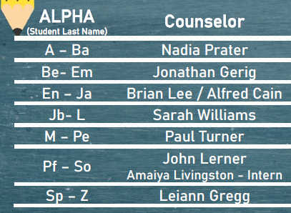
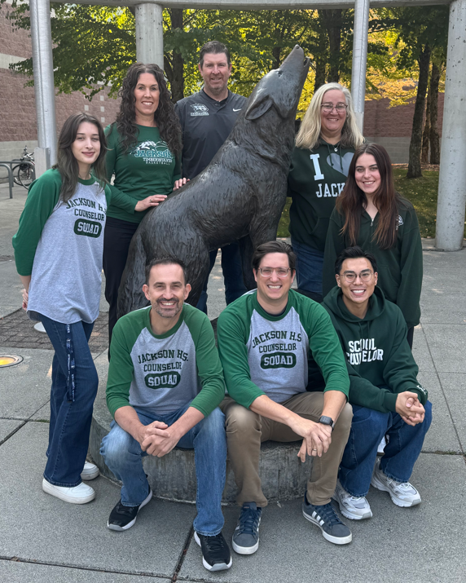
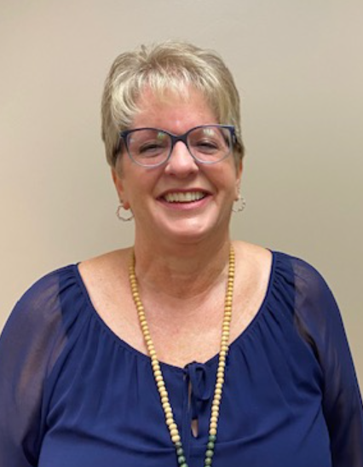
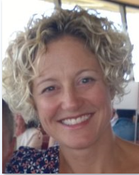
We’re here to help!
Naviance support – @ JHS Wednesday’s
Mrs. Sarah Pewitt
naviance@everettsd.org
Registrar:
Mrs. Heather Coon
JHSTranscripts@everettsd.org
425.385.7015
Transcripts

Slide 3

Remember to invite your parent(s) / guardian(s)
Add this important event to your calendar & invite your parent(s) via text right now!!

Slide 4
What is post-secondary?
Post-secondary refers to any college, training program and/or career plans after high school graduation.
Post-Secondary Options
Apprenticeship
Community & Technical Colleges
Employment
Four-Year College & University
Internship
Military

Slide 5
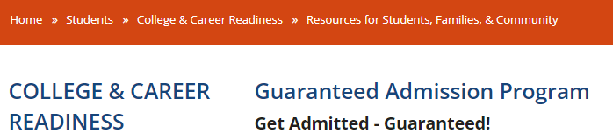








Guaranteed Admission Program (GAP)
3.0 or higher (3.3 PLU)
On track to meet graduation requirements (CADRs)
Automatic Admission
Fill out application
Check email for specifics
Next upload after first semester
Lower GPA? Schools will continue to do a wholistic review of each application!
Notes:
Even if they do not have a 3.0 for WA GAP, schools will continue to do a wholistic review of the application. Our district will do another upload of transcripts after first semester so if they meet the 3.0 GPA they will also get the email like students in the fall.

Slide 6




Job Prep

Slide 7

Career Bridge Washington
www.careerbridge.wa.gov

Slide 8
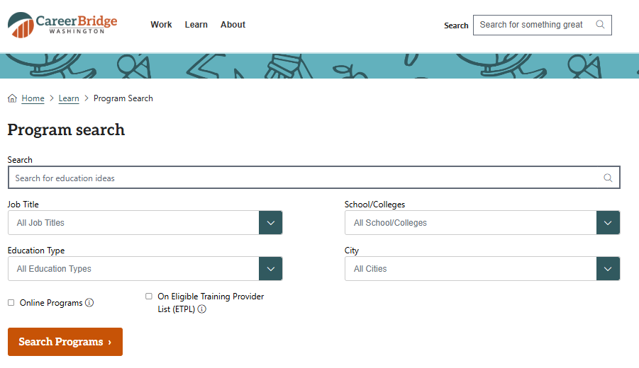
Want to look at all options?
www.careerbridge.wa.gov
Type in interest area
Keep All Education Types
Review your results for:
Apprenticeships
Certificates
Degrees etc.
Filter by location

Slide 9

OCT. 7 Trade Up Event See Mr. Dahlke for more info

Slide 10
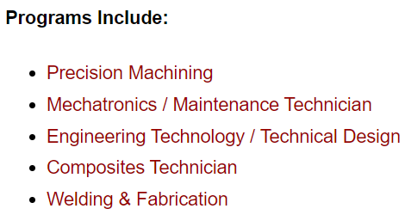


Advanced Manufacturing Training & Education Center (AMTEC) Everett Community College

Slide 11


Washington Aerospace Training & Research Center (WATR) Edmonds College
FREE!

Slide 12
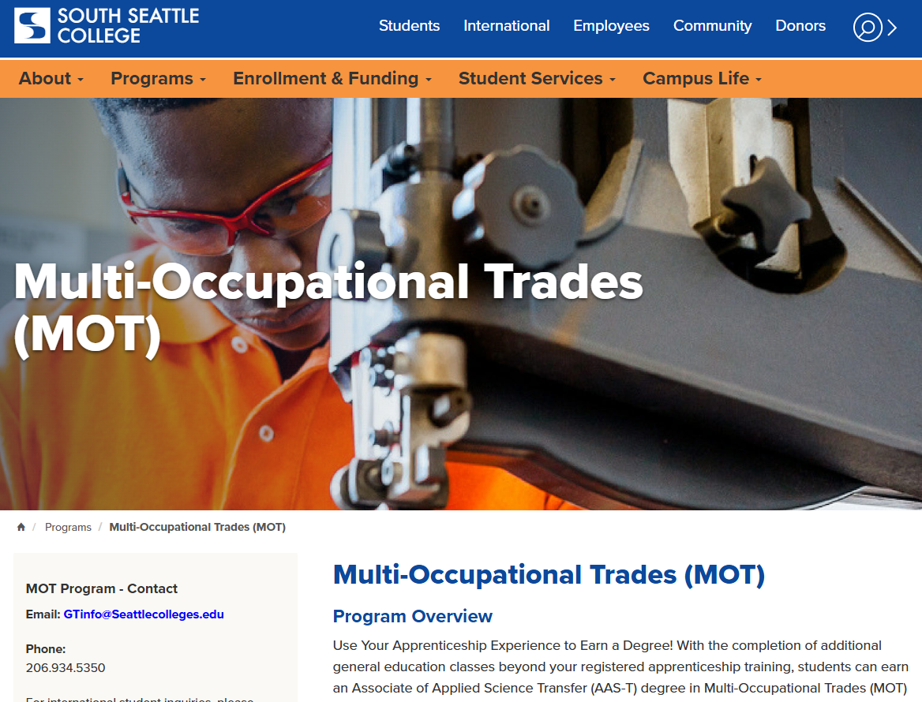
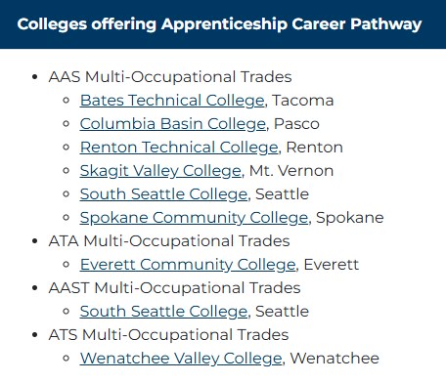
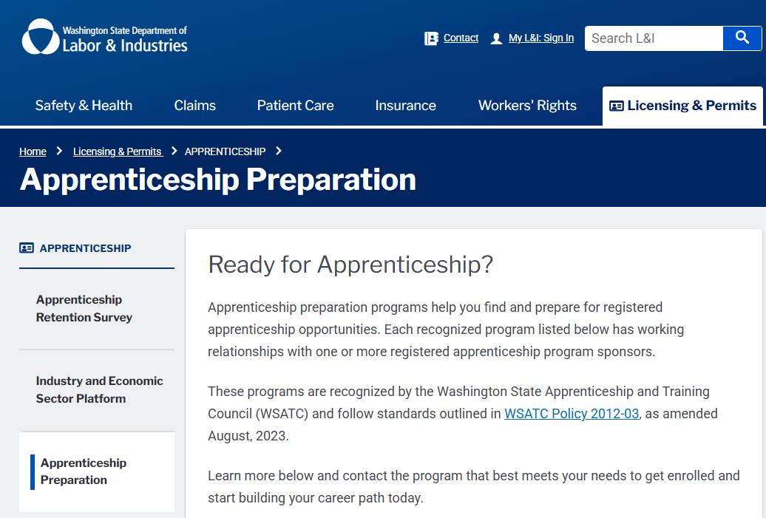
Apprenticeships

Slide 13
Apprenticeships
An apprenticeship combines on-the-job training with related classroom instruction, all under the supervision of a journey-level professional. Apprentices get paid while they learn and develop knowledge, skills, and abilities in a new career field.
Apprentices receive a professional credential that is recognized nationwide.
Who can be an apprentice?
Anyone can be an apprentice. In general, apprentices must:
Be at least 16 years or older, or in the case of hazardous occupations, 17 years or older.
Be able to perform the work, with or without reasonable accommodation.
Have the knowledge, skills, and abilities needed to learn the job.
Provide proof of age, high school diploma or equivalency (GED), honorable military discharge, etc., to meet program requirements.

Slide 14
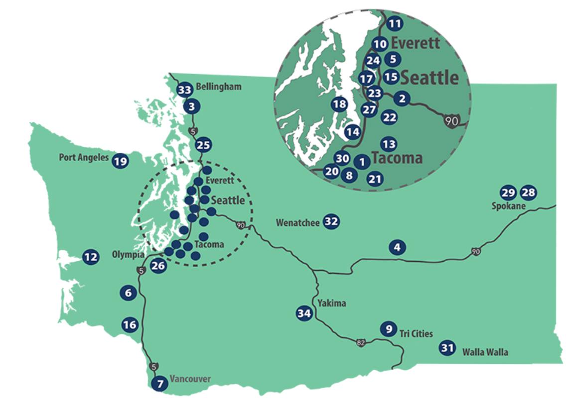
Certifications
34 colleges in Washington State
All on 1 application
All offer a variety of certificates in technical and trades
All offer stackable certificates that can be applied towards a degree or directly enter workforce!
www.sbctc.edu

Slide 15
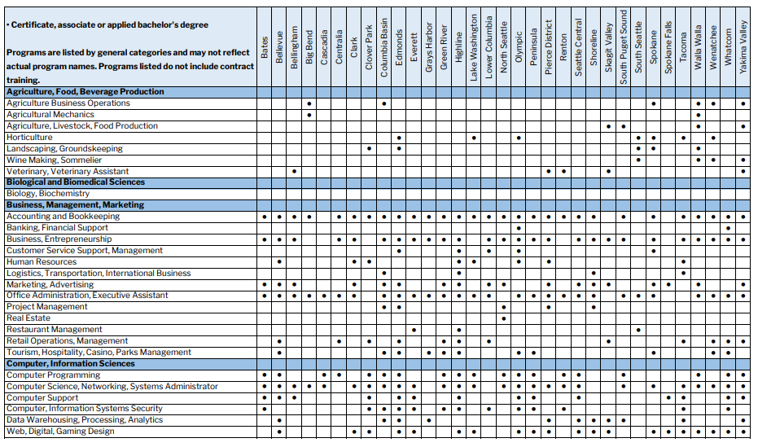
WA Community & Technical College Programs
Looking for a specific training program or degree?
Mr. Dahlke &/or your counselor can help you find where programs are offered!

Slide 16
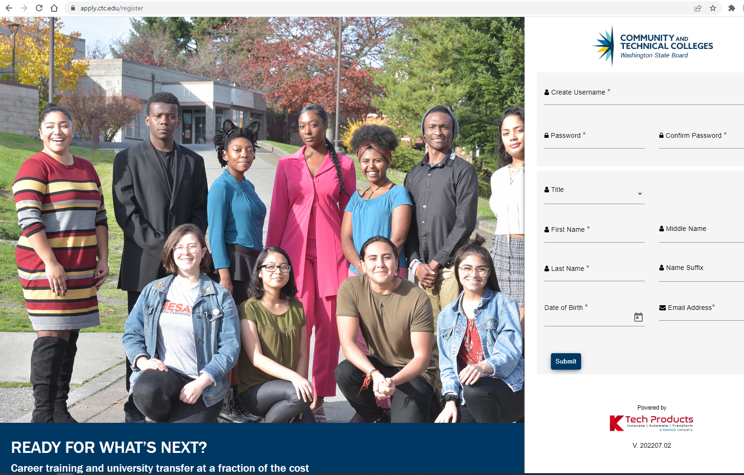
Community & Technical College Application

Slide 17

Military Options

Slide 18
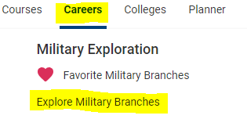
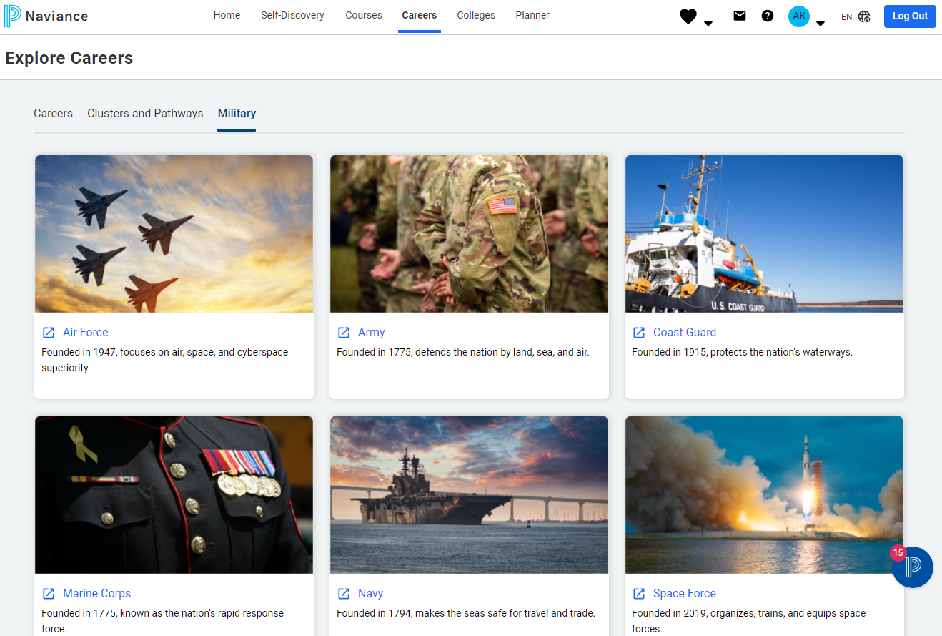
To sign up for the military, you should start by contacting a recruiter, then take the ASVAB test, pass a physical exam at MEPS, choose a military job (MOS) with a recruiter, and finally sign your enlistment contract and prepare for Basic Training.
Military
Options

Slide 19

Job Corps

Slide 20

Peace Corps
The Peace Corps is a U.S. government agency that sends Americans to live and work in communities abroad for 27 months on projects in areas like education, health, and agriculture to promote world peace and friendship. Founded by President John F. Kennedy in 1961, it operates in various countries to meet local needs, while also fostering a greater understanding of Americans by the people served. Citizens can serve as volunteers for long-term assignments or through short-term, skilled opportunities with Peace Corps Response

Slide 21

AmeriCorps is a federal agency connecting Americans to opportunities to serve their communities and country. It comprises three core programs—AmeriCorps State and National, AmeriCorps VISTA, and AmeriCorps NCCC—along with AmeriCorps Seniors. Members serve with local, state, and national non-profits and community organizations in areas like disaster relief, education, and environmental stewardship. In return for their service, members receive benefits including a Segal AmeriCorps Education Award to pay for college or loans, and some receive health insurance, living allowances, and other benefits.
What AmeriCorps Does:
• Connects service and need:
AmeriCorps links individuals to serve in intensive service to meet critical community needs.
• Focuses on national challenges:
Services address areas such as disaster services, economic opportunity, education, environmental stewardship, healthy futures, and veterans and military families.
• Supports community organizations:
Members serve with a wide variety of non-profits, schools, public agencies, and faith-based and community organizations.

Slide 22
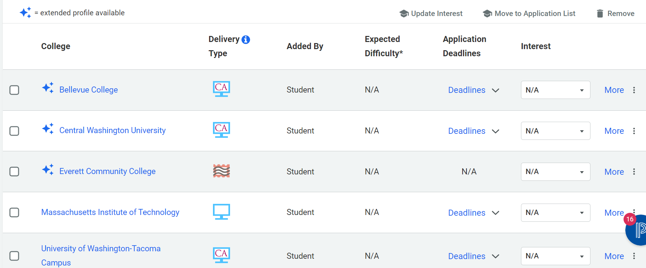
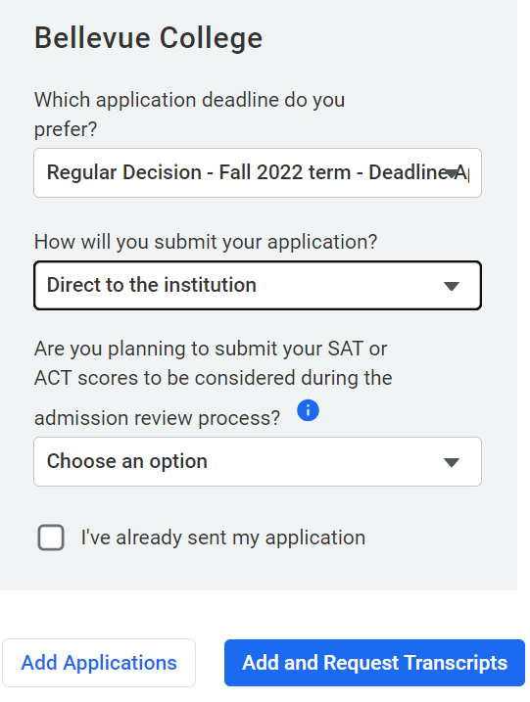
Requesting Transcripts
The Colleges I’m thinking about list is where you start!
Only move the colleges to the Colleges I’m applying to list when you plan to submit applications.
2.
1.
3.
Click MOVE TO APPLICATION LIST
Click ADD AND REQUEST TRANSCRIPTS

Slide 23
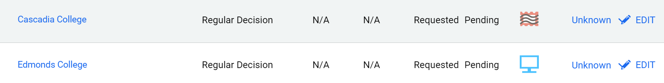
Understanding App Process
Check due dates!
Check how you plan to apply!
Edit your application status
Track progress of application materials

Slide 24


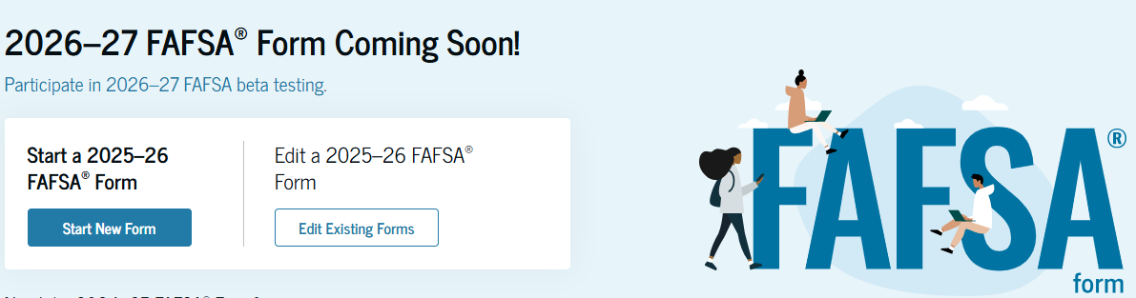

Financial Aid Opens Oct. 1

Slide 25
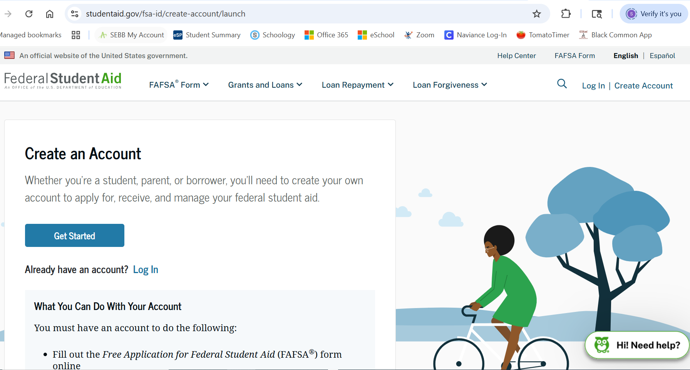
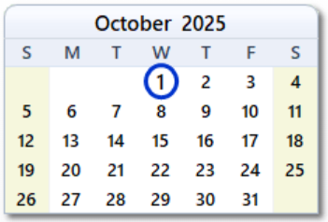
Financial Aid
DO NOT… Pay someone to get your Federal Student Aid ID created or give a “3rd
party” your Social Security number

Slide 26


Financial Aid Assistance
October 15:
HS & Beyond Family Night breakout sessions to help understand Financial Aid
1. FAFSA / WASFA Completion
Bring your questions as you get ready to complete the FAFSA or WAFSA
2. Financing your Educ.
Learn the basics about financial aid
October 29:
Financial Aid Help Night, 6 – 8 PM
Students & families receive help completing FAFSA & WASFA financial aid applications. Interpreters available, light snacks, no childcare.

Slide 27

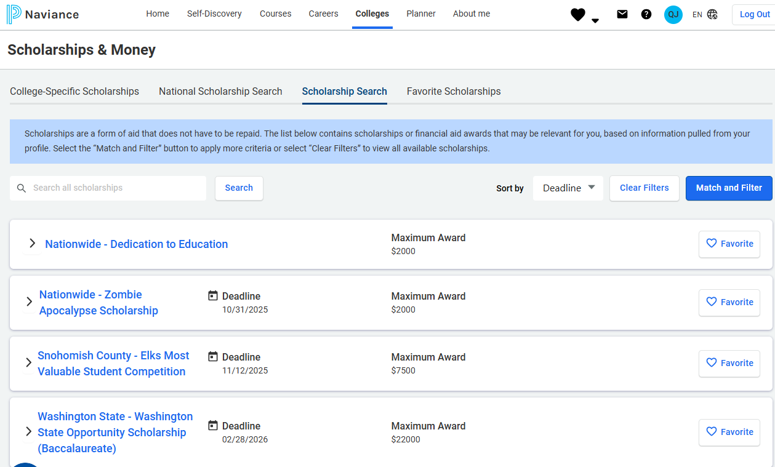
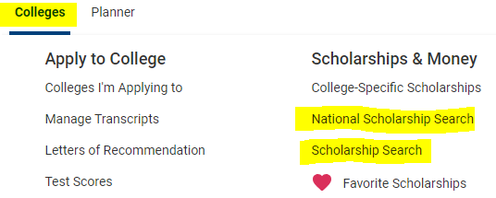


Scholarships
Notes:
Check out the college/career webpage for a helpful resource on scholarship opportunities.

Slide 28

Your High School & Beyond Plan
Your High School & Beyond Plan is a graduation requirement.
Shows up on your official transcript as MET

Slide 29
Important Dates & Updates!
Check application deadlines!
Use district login for Naviance from JHS Student Tools page
Canvas is where you find the CCRS course
Financial Aid (FAFSA/WASFA) opens October 1
Financial Aid Family Night @ JHS 10/29, 6-8 PM!
High School & Beyond Night is October 15
Need help with something related to post-secondary planning?
See Mrs. Pewitt Wednesdays in JHS Career Center, NAVIANCE@everettsd.org

